Slide 1
Using Matomo to collect data on intervention engagement within a research trial: the Wrapped project

Slide 2
Overview
Why is it important to measure intervention engagement within a research trial?
Brief intro to the Wrapped research project
How we used Matomo to collect individual-level data on engagement
Early insights from our analytics data
Q&A

Slide 3
Why is it important to measure intervention engagement within a research trial?
To minimize non-usage attrition
To examine and control for dose

Slide 4
Minimising non-usage attrition
Trials of new interventions are typically performed using Randomised Controlled Trials (RCTs)

Slide 5
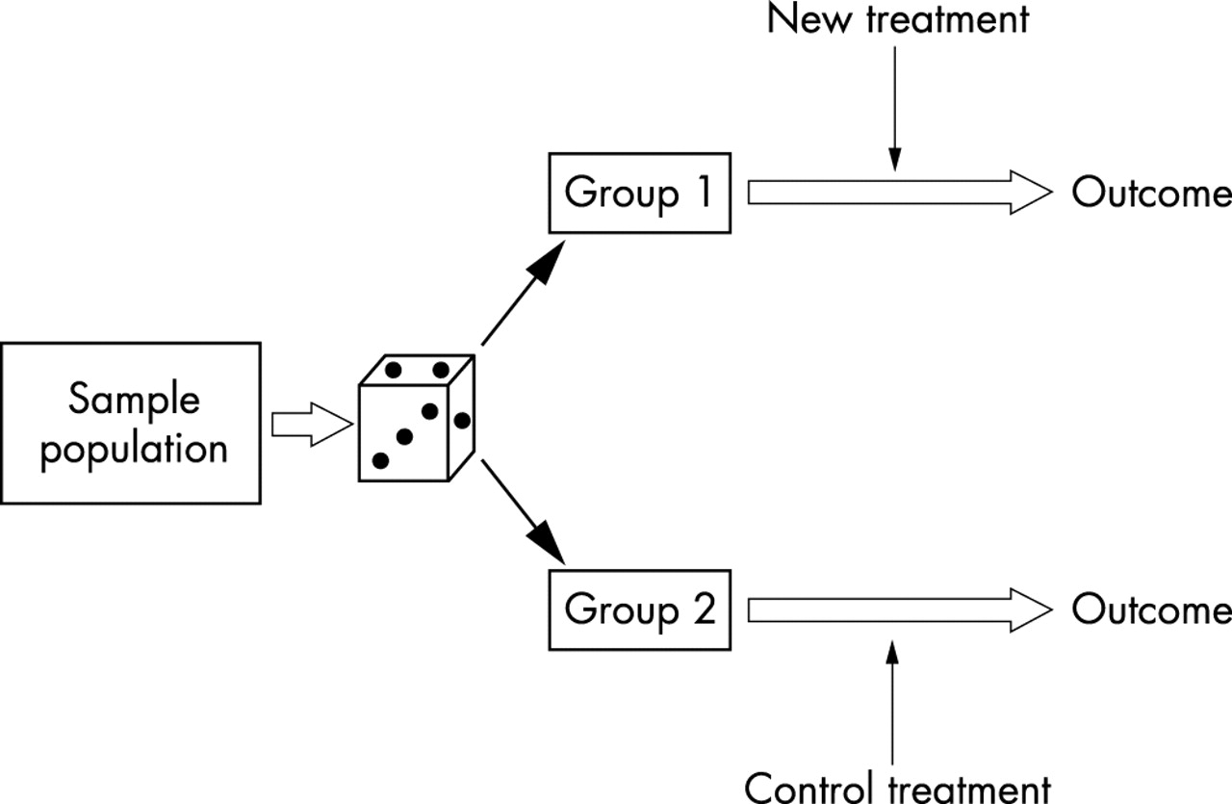

The randomised control trial
J M Kendall Emerg Med J 2003;20:164-168
Copyright © BMJ Publishing Group Ltd and the College of Emergency Medicine. All rights reserved.

Slide 6
In a clinical context, where a new drug is being tested, adherence to the drug is not usually a problem:
  The drug is ‘prescribed’
  Participants are closely supervised, and
  They may experience observable and immediate health benefits in taking a drug

Slide 7
In contrast, adherence is a major problem in trials of eHealth interventions
  eHealth intervention is any intervention delivered via the internet
Here the intervention is neither prescribed nor critical to wellbeing

Slide 8
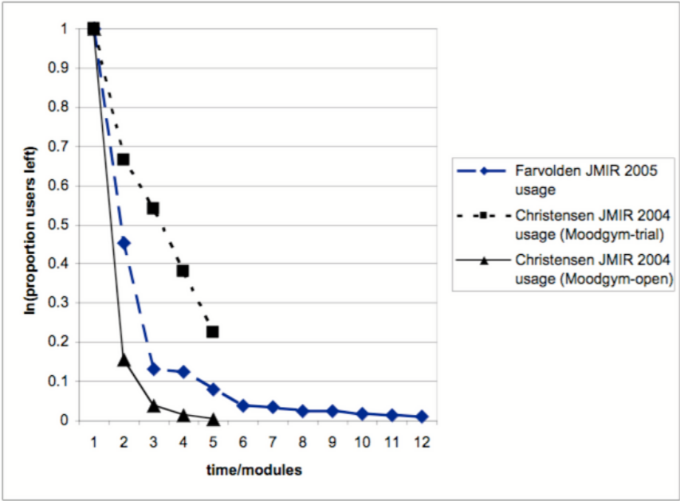
Notes:
Attrition curves plotted for 3 studies (Farvolden 12 week programme; Christensen, 5 modules, open and closed i.e. within trial, availability). Follows attrition of all those who complete one module or one week of programme. For Farvolden, only ~1% completed the programme. For Christensen, 0.5% completed in ‘open’ setting and 22.5% in ‘closed’ setting.

Slide 9
The problem of non-usage attrition in trials (i.e. participants ceasing use of the intervention) is that if participants are not using the intervention then it makes it difficult to test whether it actually works
In trials, outcome data for every participant randomized will be included in the analysis
  Regardless of whether they adhered to the intervention or not – ITT analysis
  This has the effect of underestimating the effect of the intervention
It is therefore really important to do what we can to minimize non-usage attrition
Notes:
ITT analysis:
In an RCT all known and unknown factors are controlled for so that the only thing that differs between the two groups is the intervention.
A key method for achieving this control is randomisation – in theory, participants in the two groups should be balanced such that there is for example, an equal number of males/females, distribution of ages, ethnicity, IMD etc.
If you only analyse those that received all/or a threshold amount of the intervention then this balance can be affected, biasing the results
In theory you could also remove an equal number from the control group but identifying matched controls would be almost impossible
Underestimating – because a proportion of those providing outcome data included in the analysis won’t have received all/some of the intervention (and therefore their outcomes will presumably be unchanged)

Slide 10
It is usual practice to conduct a feasibility trial ahead of a main trial
A fRCT is the same as an RCT in every way except the study is run with fewer participants
The purpose is to help the team prepare for the full RCT
  Resolve ‘unknowns’ e.g. what is the best method for recruitment, what level of incentive is required to keep participants in the trial until the end?

Slide 11
An fRCT can also be used to examine non-usage attrition
  Analyses can also tell us whether attrition is associated with demographic factors
  The shape of the attrition curve can tell us something about underlying causes
Notes:
If associated with demographic factors, this would tell us that there is possibly something about the content that puts certain groups off – this can then be explored further e.g. through interviewing a sample of users

Slide 12
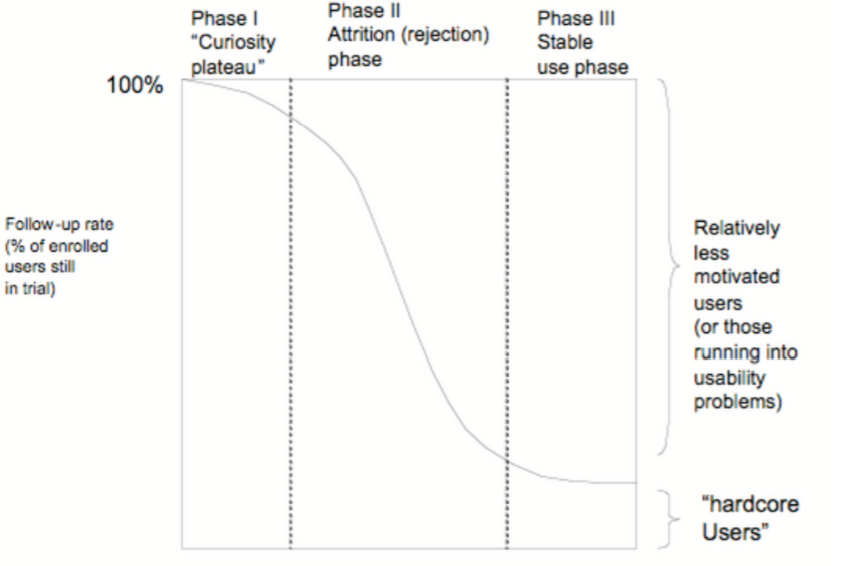
Notes:
Shape of curve: e.g. sharp steep straight line slope indicates immediate dislike with no hardcore remaining users; sigmoid curve (shown here) suggests initial interest and remaining hardcore group.

Slide 14
It is not uncommon for eHealth fRCTs to measure non-usage attrition, but measures of engagement are usually limited (not fine-grained) e.g. continued access to website, completing modules etc.
The use of analytics data rarely happens
  Aware can offer greater insight into usability issues*
    e.g. friction points
  Which can be further explored through qualitative research
  With aim of addressing any issues to reduce non-usage in the main trial
  * Common place in web industry – expertise exists; we could gain a lot from collaboration

Slide 15
Examining and controlling for dose
The ‘amount’ (or dose) of intervention a participant receives in a trial may affect the strength of the outcome (assuming the intervention is indeed effective)
You can’t examine what you don’t measure
For each individual participating in a trial, we need to know ‘how much’ of the intervention they had

Slide 16
Examining and controlling for dose
This enables researchers to examine:
  Whether there is a linear relationship between dose and effect (the more you have, the greater the benefit)
  Or whether there is a non-linear relationship (point of saturation)
  Whether there is a minimum dose that is needed for the intervention to have an effect, and if so, what that minimum is
Analytics data is also therefore needed to provide precise and detailed measures of dose for each individual e.g.
  Which pages accessed, how long spent on page
  Which videos watched and for how long
Notes:
So, now I’ve made case for using collecting analytics data within research trials, I’d like to show example of how we’re doing this in a current fRCT.

Slide 17
A brief introduction to Wrapped

Slide 18
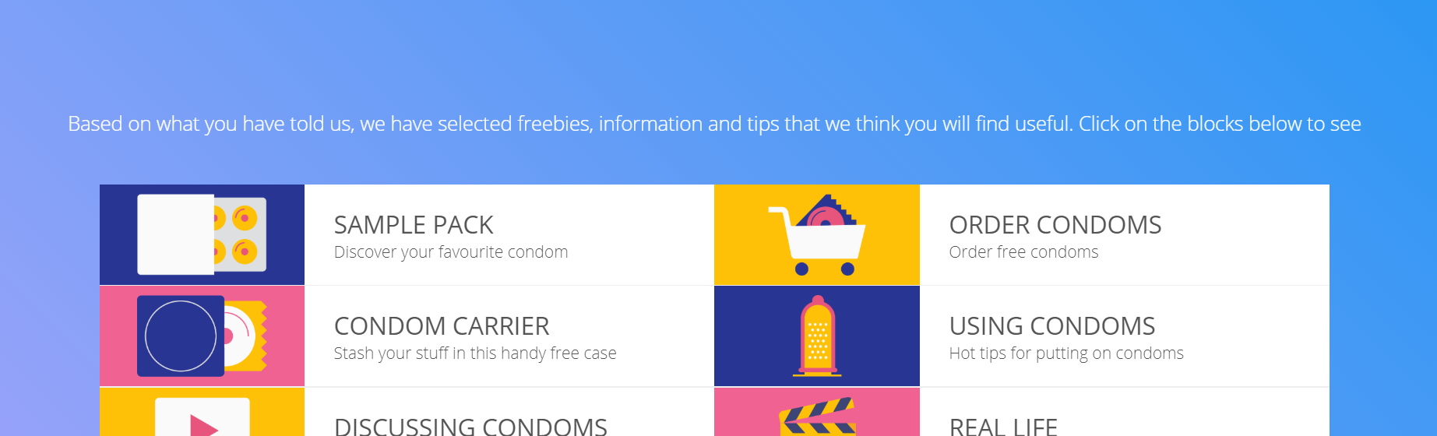
Our trial
Feasibility RCT
Aims to establish if main RCT is feasible & inform preparations
We are using analytics data to:
  better understand any possible usability issues so that they can be addressed ahead of the trial (incl. minimise non-usage attrition)
  learn how best to measure dose in the main RCT

Slide 19



Wrapped intervention
Aims to increase condom use by addressing factors such as:
  Condom use attitude, self-efficacy for communication and use, and increasing access to condoms
Content includes 6 components – tailored to individual need (not all allocated)
  3 products which can be ordered (trial pack, carrier, monthly supply)
  3 lots of videos

Slide 20



Data collection
The study requires participants to complete activities over a 12 month period
Database management software called REDCap is used to consent participants, prompt them to complete activities (email, SMS) and record their data (e.g. surveys, test results)
REDCap is also used to direct participants to the intervention (Wrapped) and control websites after randomisation.
Each participant has a unique ID against which all of their activity/data is logged

Slide 21

The problem
How do we collect individual-level analytics data?

Slide 22
The data collection part
Technology used: CodeIgniter
Number of parties involved within the project: 3 (the client, the agency, the analyst)
Key aspects of the project:
  few pages to track but critical in terms of data collection (advanced tracking code were necessary: events, custom dimensions).
  insuring to have a consistent data layer.
  have a clear QA process.
  Use of custom dimensions and custom reports was of critical importance.

Slide 23
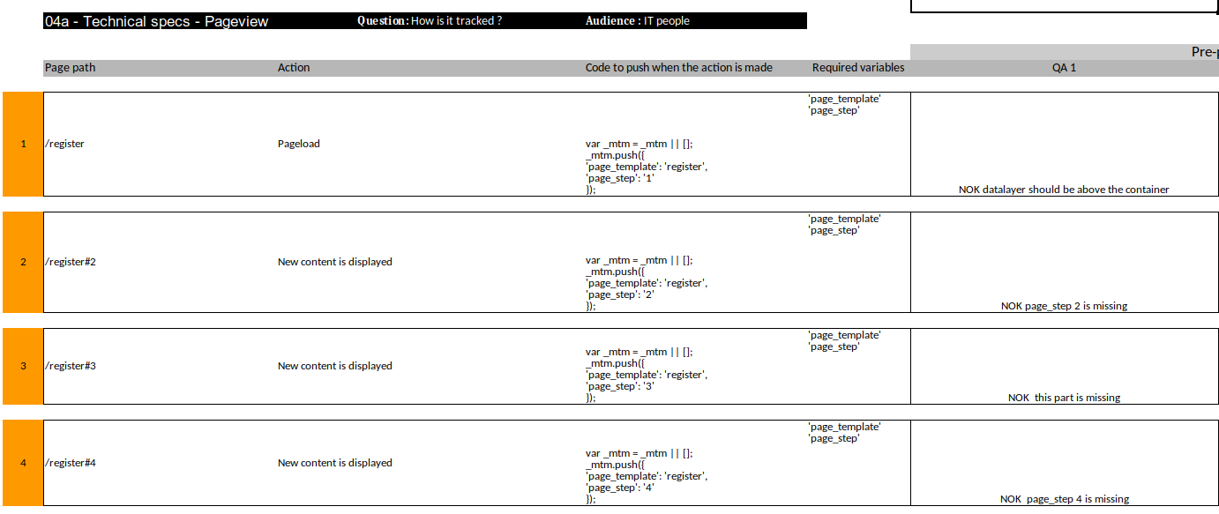
Working methodology example

Slide 24
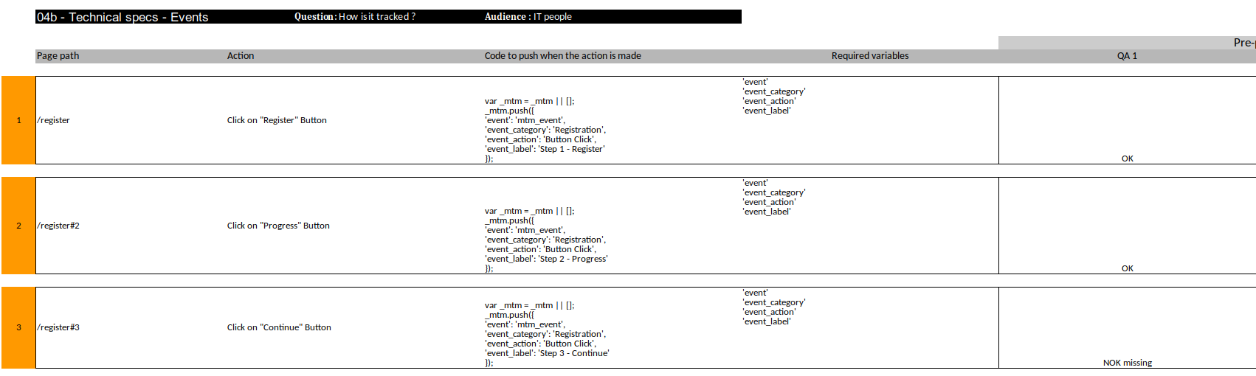
Working methodology example

Slide 25
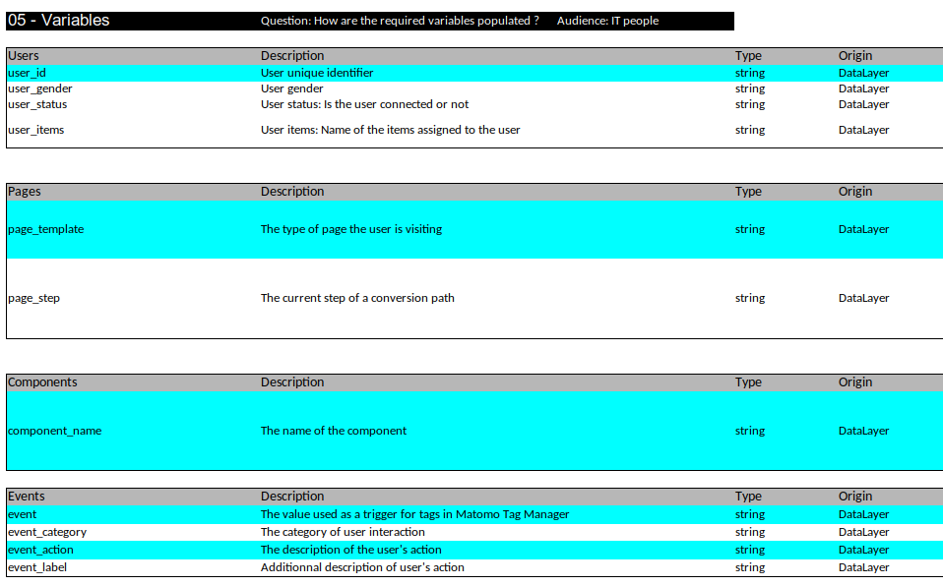
Working methodology example

Slide 26
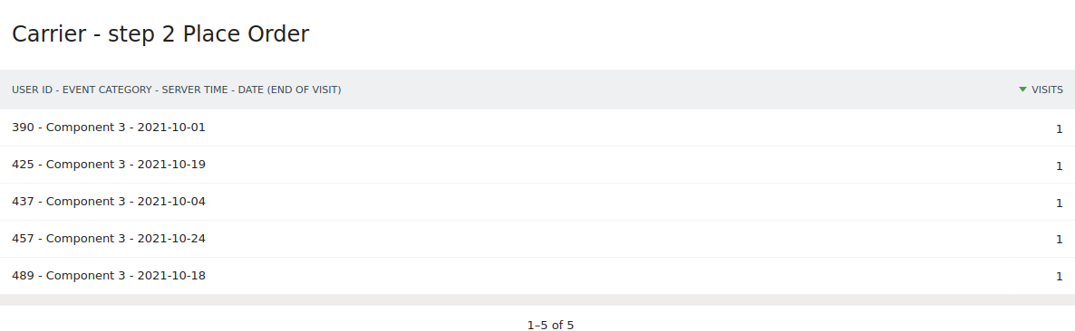
Example of reports

Slide 27
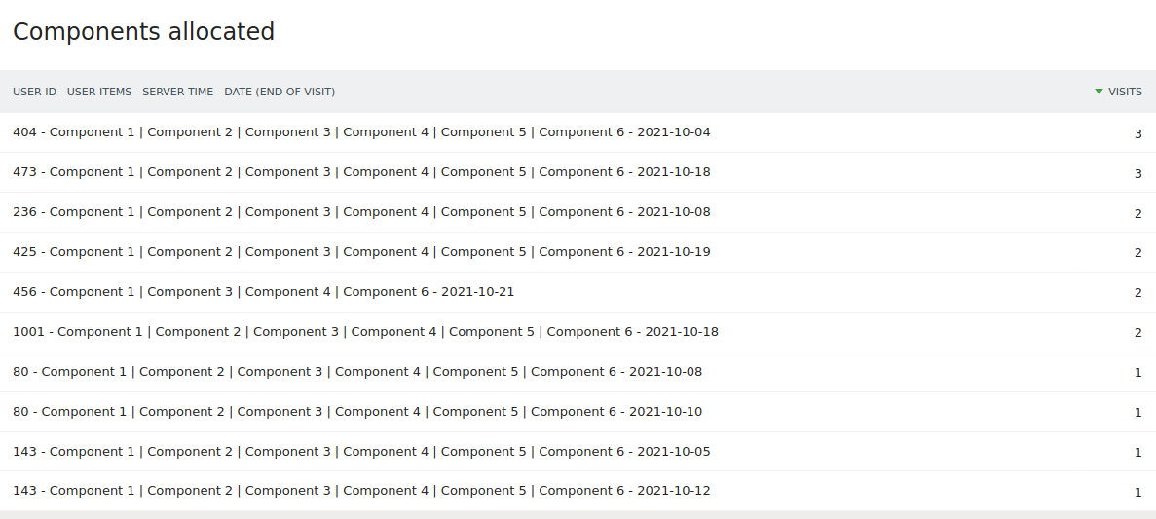
Example of reports

Slide 28
Early insights from our analytics data

Slide 29
Acquisitions
Notes:
Data presented for intervention group only (n=91)

Slide 30
Proportion of users allocated one to six components
Number of components allocated | Number of users | % of users
1 | 0 | 0
2 | 4 | 7.4
3 | 4 | 7.4
4 | 2 | 3.7
5 | 16 | 29.6
6 | 28 | 51.8
Total | 54 | 100

Slide 31
Sample box

Slide 32
Condom ordering

Slide 33
Carrier

Slide 34
Demo video

Slide 35
What we’ve learnt…
We can use analytics data to gain insights into non-usage attrition
We will use to make improvements
  Home page attracts users to visit components 1-3
  Once on component pages 1-3, good conversion to ordering
  No issues with ordering process (few drop out here)
  Home page does not attract users to video content (components 4-6)
  Component pages also not working to encourage users to then watch videos
  Videos themselves not being watched for very long
We still have lots to learn in this field about what is possible!

Slide 36
What we’ve learnt continued…
Our solution for linking capturing individual level participant analytics data successful
This means that it is possible to measure dose using analytics data gathered
We will likely use in main trial to create a standardised score based on:
  whether products allocated are ordered
  the % time allocated videos are watched for

Slide 37
Questions?
Katie Newby
K.newby@Herts.ac.uk
Ronan Chardonneau
contact@ronan-chardonneau.fr

